Slide 1
Superstore Sales Dashboard
Data Analyst Internship - Task 8
By Sirisha D

Slide 2
Objective
To analyze and visualize sales and profit performance of a Superstore across categories, regions, and time.
Build a professional dashboard using Power BI to uncover insights for strategic decision-making.

Slide 3
Dataset & Preprocessing
Dataset Details:
200 records of Superstore Sales (mock dataset generated for analysis).
Columns include: Order Date, Region, Category, Sales, Profit, Month-Year.
Preprocessing Steps:
Formatted dates.
Extracted Month-Year for trend analysis.
Verified data types and ensured numeric fields were consistent

Slide 4
Dashboard Overview
Visualizations Used:
Donut Chart - Sales by Category
KPI Cards - Total Profit and Sales
Bar Chart - Profit by Category
Line Chart - Monthly Sales Trend
Horizontal Bar - Sales by Region
Slicers - Region & Category filters
Design Focus:
Clean, minimal layout
Purple theme for contrast and visual appeal
Easy-to-read fonts and layout structure

Slide 5
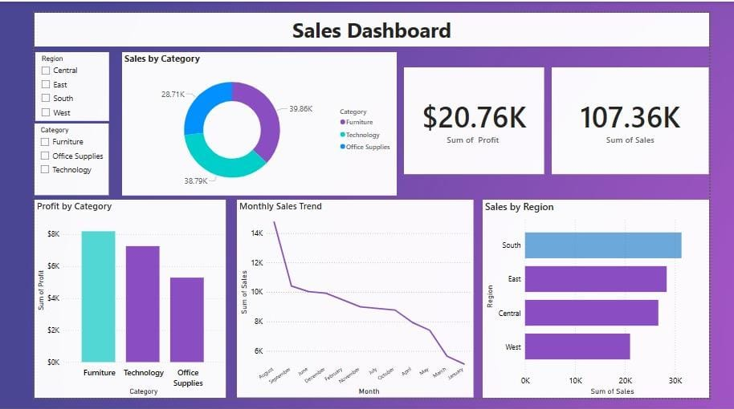

Slide 6
Key Insights
Insights Uncovered:
Technology is the top-selling category ($39.86K), but Furniture has the highest profit (~$8K).
Monthly sales peaked in August and showed a decline toward January.
South Region leads in total sales (~$30K), followed by East and Central.

Slide 7
Business Recommendations
Focus marketing efforts on South and East regions for consistent sales growth.
Promote Furniture category more aggressively to increase profits.
Analyze seasonal trends to boost sales in low-performing months like December–February.
Re-evaluate Office Supplies strategy due to lower profit margins.

Slide 8
Conclusion & Next Steps
Conclusion:
Delivered a complete BI dashboard with actionable insights.
Translated raw data into strategic decisions for business growth.
Next Steps:
Explore predictive analytics on future sales trends.
Automate data refresh & build alerts using Power BI Service.

